Slide 1
Special Session: RESEARCH PAPER FOR INTERNATIONAL MARKETING JOURNAL
Prof. Jaihak Chung, Ph.D
Sogang University, Republic of Korea & IESEG, France
Magister Manajemen
Universitas Sanata Dharma
13 Agustus 2014

Slide 2
Academic career
Professor Jaihak Chung has been on the faculty at the Business Administration of Sogang University since 2002 March. He holds a Ph.D. in Marketing, an M.S. in Quantitative Research Method from Cornell University, and an B.A. in Management from Korea University.
Editor-in-Chief of Asia Marketing Journal
Editorial Board Member of IJA(International Journal of Advertising)
Ad-hoic reviewer of JMR
Chair of ICAMA(International Conference of Asian Marketing Associations)
Industry career
Marketing Strategy Consultant for KLB (1991-1996)
Chief Consultant for Samsung CHEIL Communication(2001-2002)
Consulting cases: Demand forecasting (KT wibro service, Nespot, KT&G new products), New Product Development,
Competitive Intelligence System Titanomachia
Research Area
Professor Jaihak Chung has been focusing on customer choice modeling issues with Bayesian econometrics, innovation marketS (RNP:Really New Product), Global market strategy, Demand Forecasting, and SNS Market Research.
Innovative Product (Hightech Marketing)
New Product Ideation & Marketability Analysis (APOLLON, K-AESSOR, Samsung DC)
Brand Competition Strategy Support System (Titanomachia)
Marketing Strategy Simulaltion Game
New Marketing Model(Techniques): Latent Class Model, Brand Image Analysis, WOM management, Choice Model
Innovative Marketing Strategies & Methodologies-Korea (Lectures for foreigners)
Award
2001 MSI(the Marketing Science Institute) Winner of the 2000 Alden G. Clayton competition for the Doctoral Dissertation Competition: The Alden G. Clayton Dissertation Award (http://www.msi.org/awards/index.cfm?id=62)
2004 Paul Green Award finalist (AMA: American Marketing Association)
2004 Best Research Paper Award (KMA: Korea Marketing Association)
2008 Global Marketing Conference at Shanghai, Best Paper in High-Tech Marketing Track, “Modeling Consumer’s WOM Behavior with Subjective Evaluation and Objective Information on High-Tech Products.”
Profile
Prof. Jai Hak Chung
Professor
Sogang University
&
Affiliate Professor IESEG, France
(Major: Marketing)
jaihak@gmail.com
(H.P.) 82-10-3361-6521
(O.P.) 82-2-705-8859
Notes:
Born in South Korea
Consulting for 5 years and join the doctoral program in Cornell university in 96.
Major research topics are demand forecasting for innovative products and new communication techniques such as SNS based marketing.
I have a good relationship with business schools and firms in several countries. Beijing university… for one year…and worked with some firms for new product development and marketing strategies for Samsung electronics..
One good example is galaxy series like galaxy tab and galaxy notes. We will use samsung products as cases often in class.

Slide 3
Top journals (SSCI impact factor)
Top cited journal in all of business and economics
Journal of Marketing = 4.8
Marketing Science = 4.0
JMR = 2.4
JCR = 2.0
Journal of Service Research = 1.7

Slide 4
Introduction to Major Journals in Asia
International Journal:
Asia Journal Marketing (Korean Marketing Association)
Domestic Journals:
1. China: Chinese Journal of Management Science
(Chinese Academy of Marketing Science)
2. Japan: Journal of Marketing & Distribution (Japan Society of Marketing and Distribution)
Chieko Minami, Professor at Kobe University
3. Korea: Journal of Korean Marketing Association
(Korean Marketing Association)

Slide 5
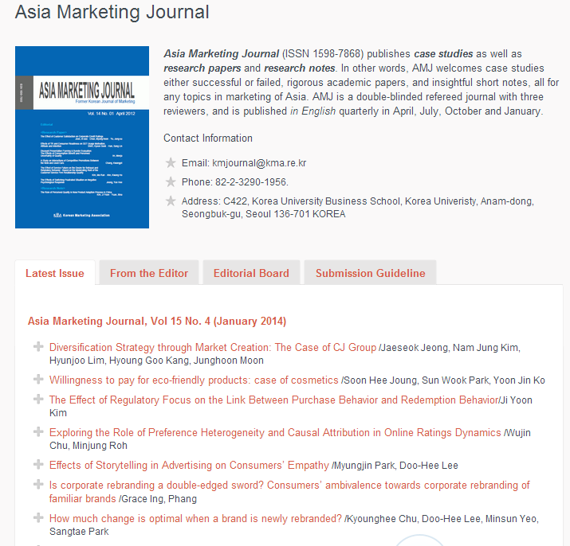
International Journal: AMJ(Asia Journal Marketing)

Slide 6
Positioning
Asia Marketing Journal (ISSN 1598-7868)
The aim of AMJ to present scholarly and managerially relevant articles on Asian markets for Asian scholars and practioniers.
Major International Journal for Marketing in Asian Countries
Academic Journal for Research Papers, Notes, Cases on Asian Markets by Asian Researchers
AMJ welcomes academic papers, cases either successful or failed, and insightful short notes, all for any topics regarding how to do marketing in Asian markets.

Slide 7
Asia Marketing Journal (ISSN 1598-7868)
http://kma.re.kr/publications/asia-marketing-journal/
A double-blinded refereed journal
with three or two reviewers, published in English quarterly in April, July, October and January.
Contact Information
Email: kmjournal@kma.re.kr
Phone: 82-2-705-8859
Address: 121-742, Mapogoo Shinsoodong 1, Sogang University Sogang Business School PA hall, #708, Seoul, Republic of Korea
Notes:
Asia Marketing Journal (ISSN 1598-7868) published by Korean Marketing Association (KMA) is a double-blinded refereed journal with three reviewers. Asia Marketing Journal is published in English and issued quarterly in April, July, October and January. The journal publishes the original papers at the forefront of marketing. We are welcoming submissions of diverse paper types including research paper, research note and case study.
Not only is the world rapidly changing, but the needs for the Journal from academia as well as industry are changing. That is why KMA is now expanding its scope beyond Korea. In fact, KMA is developing relationships with leading academic societies in China and Japan such as Council of Chinese Academy Marketing Science and Japan Society of Marketing and Distribution. Also, KMA is pursuing broader academic networks to the nations like ASEAN countries, India, Middle-East, Australia, New Zealand, Europe and North America. In an attempt to achieve our goal of contributing more to the international academic societies, KMA decided to publish Asia Marketing Journal for a wider range of readers all around the world.
Asia is now becoming the center of attention from the world. For example, let’s look at the three East Asian countries – China, Japan, and Korea. China, as you all know is undeniably the new heart of the world economy. Japan is being watched by the world for its recovery after its long period of economic downturn. And especially Korea, one of the most dynamic nations in the world, is rapidly changing due to its advanced technologies in Internet and mobile communications. For these reasons, it is not surprising to us that the world is keeping an eye on us, Asia. As a leading academic society, KMA must provide answers about Asia to the world that is full of curiosity.
We have come to a conclusion that it is about time for us to reposition our Journal as the Asia Marketing Journal. In addition to the theoretically rigorous world of academic papers, we need to introduce the Asian cases of marketing, both successful and unsuccessful. The marketing practices in Asia are still pretty unknown to the world. It is therefore our responsibility to develop the cases which will give great lessons to the managers outside of Asia especially those who want to do business in Asia. In other words, Asia Marketing Journal welcomes and will publish case studies as well as research papers and research notes not only from academic researchers but also from practitioners in the marketing fields.
I have just begun my term as the new Editor-in-Chief, with the new Editorial Board of 17 scholars from USA, China, Japan and Korea. Sooner or later, I will expand the Editorial Board with more hard-working and energetic scholars, from other Asian nations and the rest of the world, interested in marketing of Asia. After all, our Journal is now the Asia Marketing Journal.
Although the authors are required to pay submission fee and, in the case the paper is accepted, the publication fee, I will, during my editorship of two years, support the authors by offering incentives for submission in three ways. First, authors who paid the submission fee, regardless of the final decision, will receive the submission incentives from KMA after the completion of review process. Second, authors who paid the publication fee will receive the publication incentives from KMA after the publication of their paper. Third, submission and publication fees are waived if all of the co-authors have no affiliation at all in Korea. In other words, authors from outside of Korea are exempted from paying the submission and publication fees.
Finally, your contributions to Asia Marketing Journal will be greatly appreciated.
Sincerely,

Slide 8
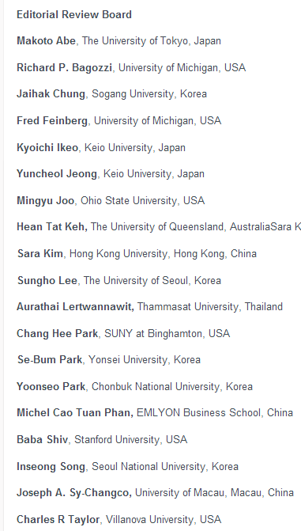
1. Asia Marketing Journal
Asia Marketing Journal (Since Vol. 14)
A major journal certified by NRFK(National Research
Foundation Of Korea) (2003~2013)
Under review of SCOPUS (2012. Dec)
Editorial Board
Korea (6)
China (5)
USA (5)
Japan (3)
Austrailia (1)
Thailand (1)
Special Issue for 2014 ICAMA
15 papers under review
Date of Publication : July or November
Special Issue for Cases in Asian Markets (Fall, 2014)

Slide 9
Popular Topics
How to glocalize in Asian markets
Cross-cultural Marketing Strategy
Cross-cultural services/channel marketing
Cross-cultural advertising
Global marketing strategy in Asian markets
Global branding in Asia
Global pricing Strategy
Product innovation across markets
Big Data or SNS – based Marketing
Any Research Methodologies for Cross-Cultural Study

Slide 10
Types of Papers Acceptable in International Marketing Journals
1. Hypotheses papers
2. Empirical Research Papers
3. Review Papers
4. Research Notes

Slide 11
What type of papers are good for publication?
#1. Interesting/Fresh Questions
#2. Meaningful and Practical Implications
#3. Good(?) Data
#4. Methodology: good enough to solve the question.

Slide 12
Hot topics
Big Data – based Marketing in Asian Markets
Big data Analytics
How to use Big data for Marketing
Etc.
Submission deadline: September 20, 2014
Published in January 2015
Cross-cultural Marketing in Asia
How to glocalize products
Methodologies for Cross-cultural Studies
Etc.
Submission deadline: December 20, 2014
Published in April 2015

Slide 13
Why is AMJ for Your paper?
The journal for Asian researchers about Asian Markets by Asian Association
Constructive Review for Asian Scholars
Rejection rate 44%
Not only Research Papers but also Cases, Research notes are welcome!
No fees for review and publication
2 weeks for review, no more than 2 rounds of review

Slide 14
Thank you Questions?

